Slide 1
INVENTORY MANAGEMENT SYSTEM (INVENTORIFY)

Slide 2
PROBLEM STATEMENT
1.Warehouse Efficiency:
Inventory management controls at the warehouse is labor-intensive and involves several steps, including receiving and putaway, picking, packing and shipping. The challenge is to perform all these tasks in the most efficient way possible. (1)
2.Inaccurate Data:
You need to know, at any given moment, exactly what inventory you have. Gone are the days when inventory could be counted once a year with an all-hands-on-deck approach. (1)
3.Limited Visibility:
When your inventory is hard to identify or locate in the warehouse, it leads to incomplete, inaccurate or delayed shipments. Receiving and finding the right stock is vital to efficient warehouse operations and positive customer experiences. (1)
References:
1.N. (2022, February 4). Inventory Management: 20 Challenges, 20 Solutions. Oracle NetSuite. https://www.netsuite.com/portal/resource/articles/inventory-management/inventory-management-challenges.shtml

Slide 3
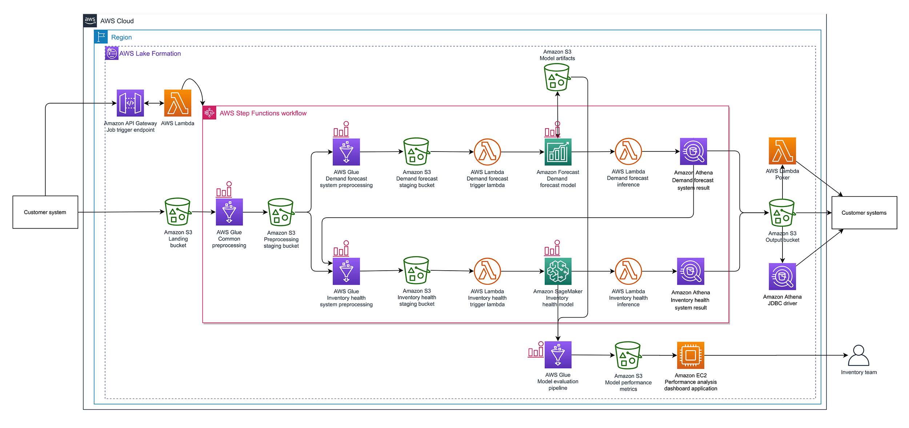
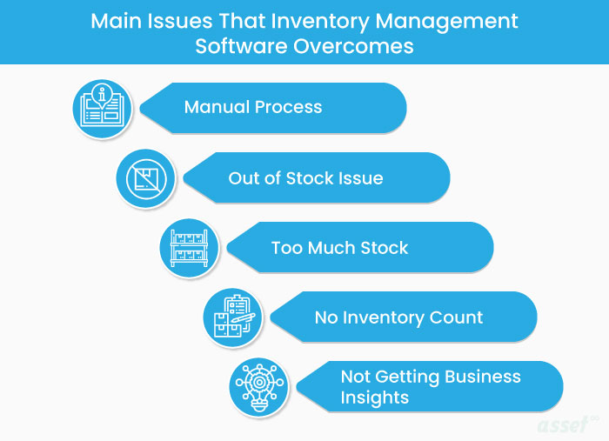
PROBLEM STATEMENT

Slide 4
SOLUTION
The goal of an inventory management system is to automate and optimize these processes, providing real-time visibility into inventory levels and allowing managers to make data-driven decisions about stock levels and replenishment. An ideal inventory management system should:
1. Provide real-time visibility into inventory levels and stock movements
2. Automate the process of tracking stock levels and generating reports
3. Allow managers to easily make decisions about inventory replenishment
4. Minimize the risk of stock shortages and overstocking
5. Improve accuracy and efficiency in inventory management

Slide 5
TEAM WORK
Ibrahim Khan (E21CSEU0339) - Shipment Module of the backend code.
Kajal (E21CSEU0356) - Sales side code of the backend.
Ishank Kapoor (E21CSEU0344) - Inventory Module of the Backend Code
Jayant Mittal (E21CSEU0349) - Front End of the Code and making the User interface easy and fun to interact with.

Slide 6
UI DESIGN
inventory@gmail.com
inventory@123
salesperson@gmail.com
salesperson@123
shippement@gmail.com
shippement@123

Slide 7
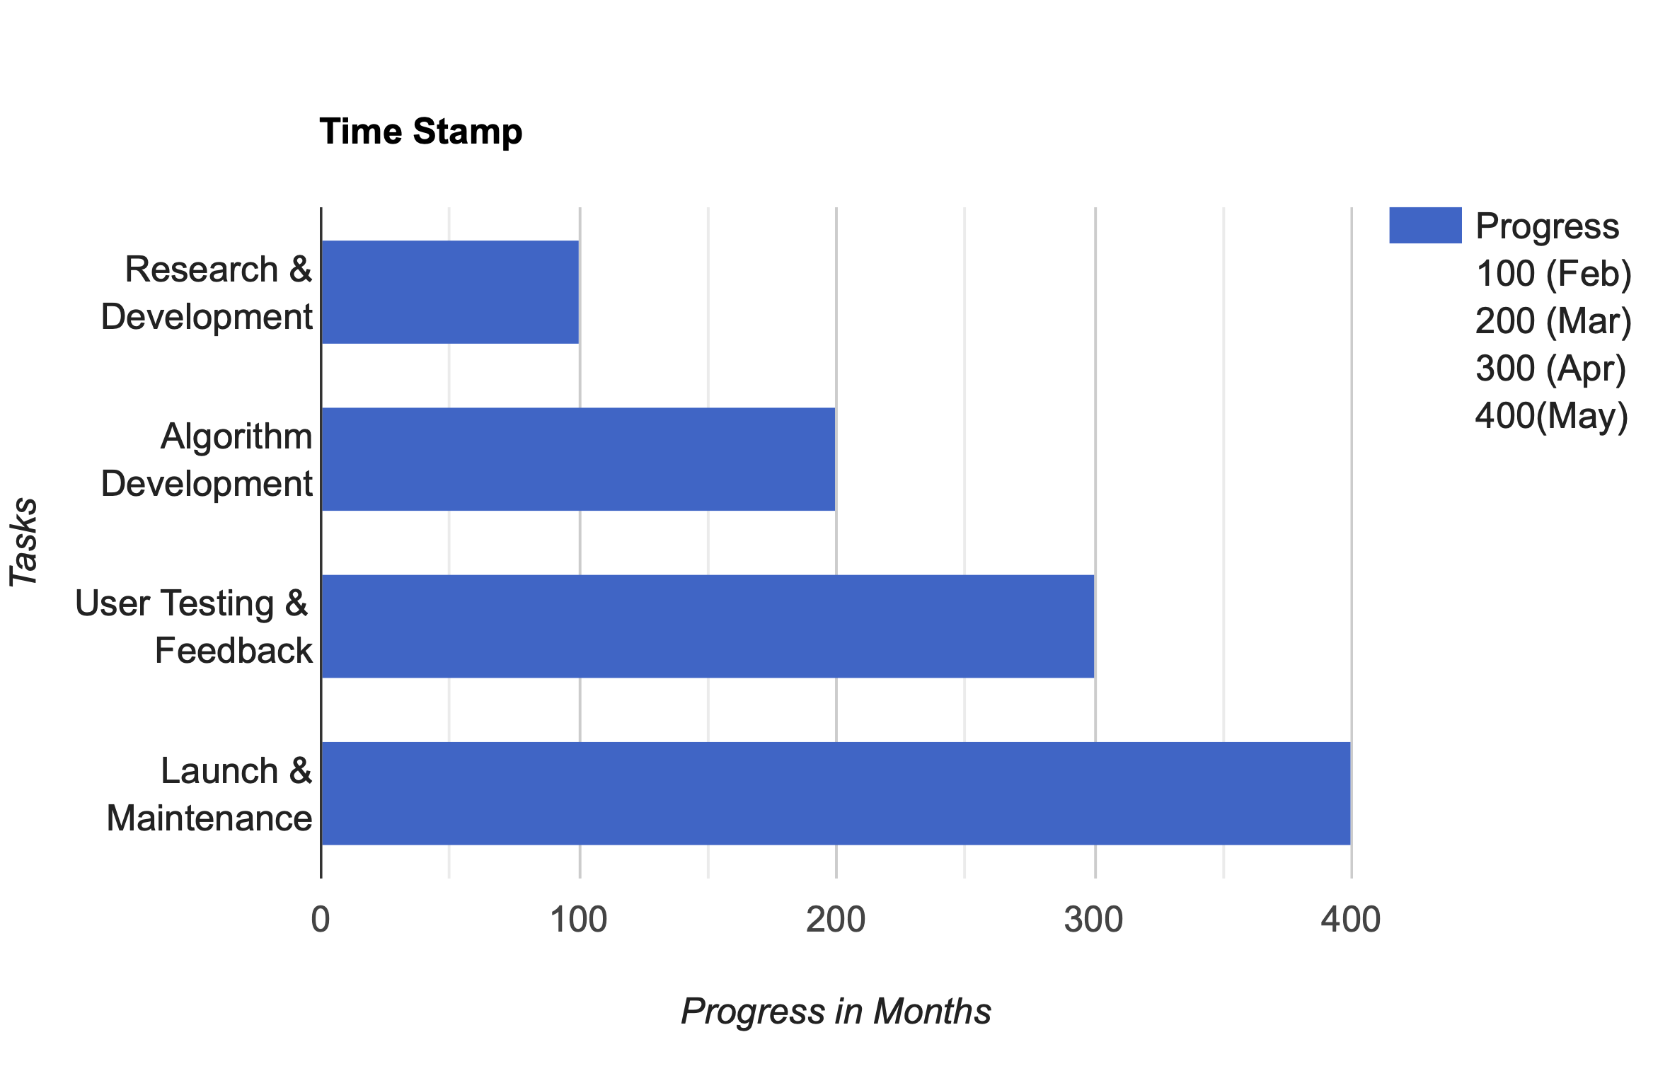
Time Stamp

Slide 8
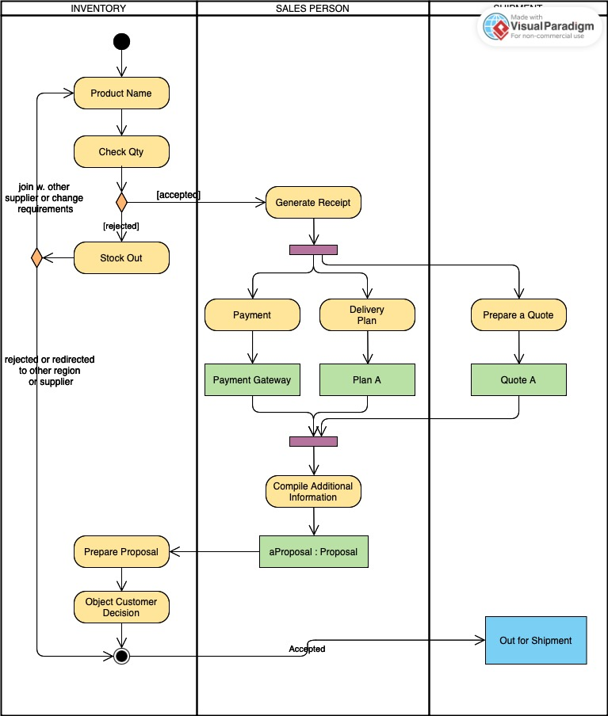
Activity Diagram

Slide 9
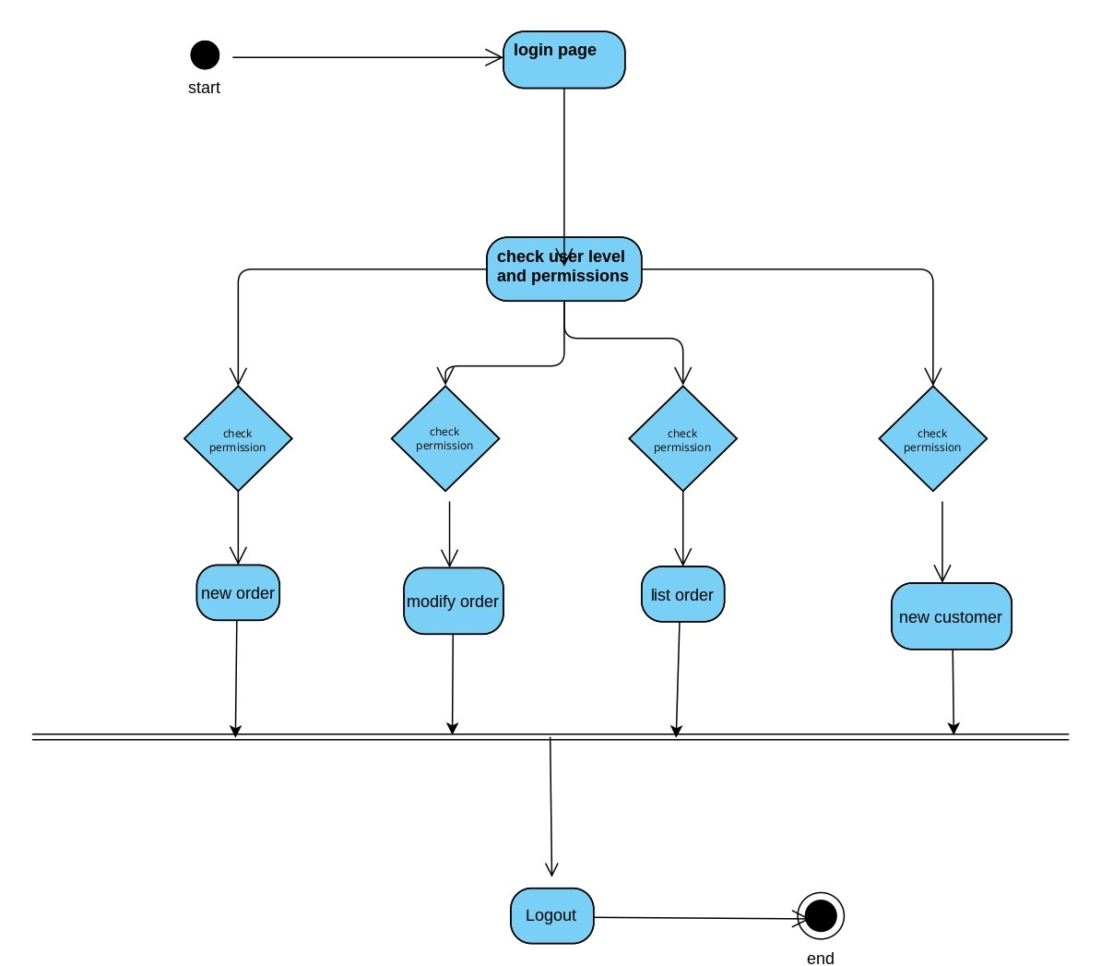
Inventory Activity Diagram

Slide 10
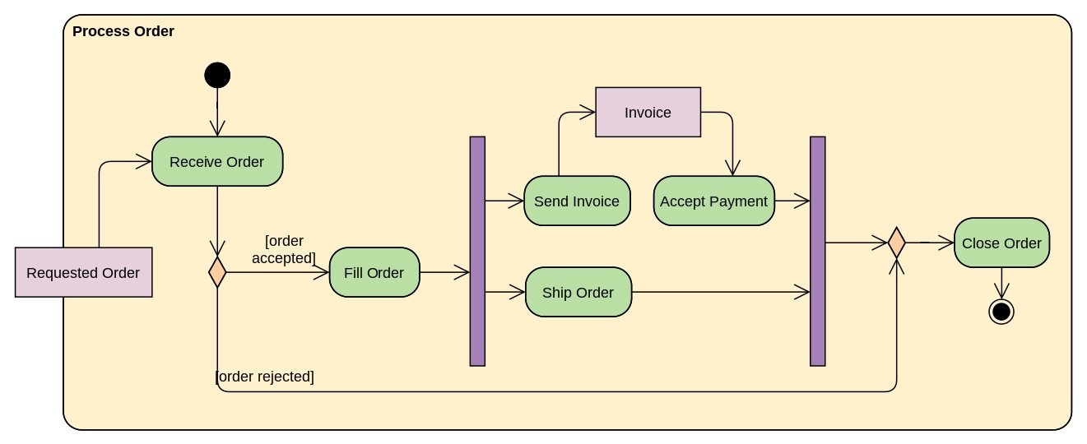
Sales Activity Diagram

Slide 11
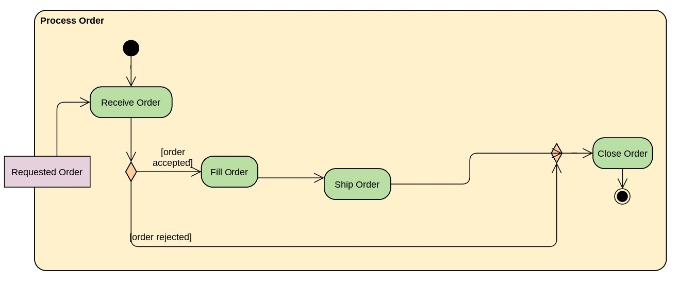
Shipment Activity Diagram

Slide 12
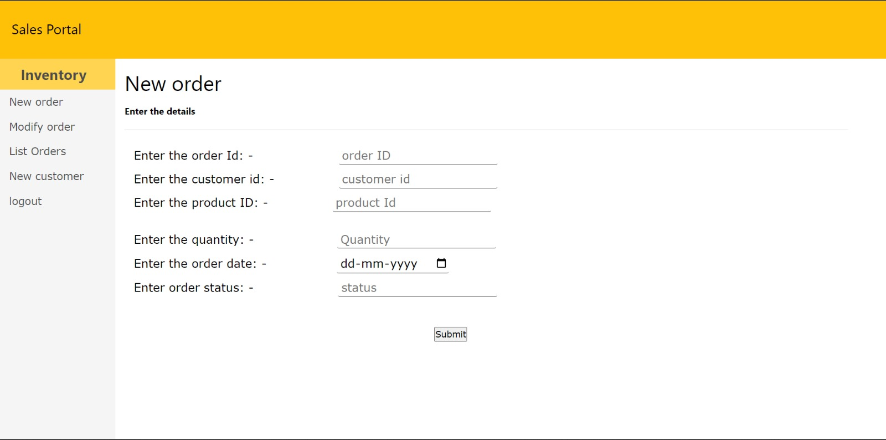
Layout Design

Slide 13
THANKS 🙏

